Slide 1
Data Management I (Data Profiling and Quality Dimensions)
Electric Vehicles-Sales Data
Team:1
Disha Gayathri Umashankar
Samyukta Krishna Tarun
Sandhya Tripathi
Shruti Pardeshi
SRH Hochschule Heidelberg

Slide 2
Roles and Responsibilities :
Disha Gayatri Umashankar | Data Preprocessing
Samyukta Krishna Tarun | Gathering Insights
Sandhya Tripathi | Data Acquisition and Data Cleaning
Shruti Pardeshi | Data Cleaning and Preprocessing

Slide 3
Table of Content
Problem Statement
User Story
Data Sources
Data Acquisition
Data Profiling
Data Preprocessing
Insights
Conclusion

Slide 4
Problem Statement
Understanding and Accelerating the Adoption of Electric Vehicles (EVs) Across American Counties (2018-2024)
Electric Vehicle (EV) adoption in the U.S. from 2018 to 2024 shows significant regional disparities, with some counties seeing rapid growth while others lag behind. Understanding the factors driving these trends—such as infrastructure, local policies, and consumer behavior—is crucial for accelerating nationwide EV adoption.

Slide 5
User Story
User Story as a Data Scientist
Title: Analysing Electric Vehicle (EV) Trends Across American Counties (2018-2024)
As a:
Data Scientist working on sustainability initiatives.
I want to:
Analyze the trends in Electric Vehicle (EV) adoption in various counties across the United States from 2018 to 2024. This analysis will focus on the growth, regional disparities, and potential factors influencing EV adoption in different counties.
So that:
I can provide insights to policymakers, car manufacturers, and environmental organizations to help them understand the growth trajectory of EVs and identify areas where more infrastructure or incentives might be needed to accelerate adoption.

Slide 6



Data Sources

Slide 7
Data Acquisition
Electric Vehicle Dataset Features:
Electric Vehicle Types (BEV & PHEV)
Model Year
Make
Model
Vehicle Id
City
County
State
Electric Vehicle Sales Dataset Features:
Sales Price
Sales Date
Manufacturing Year
Location
VIN

Slide 8
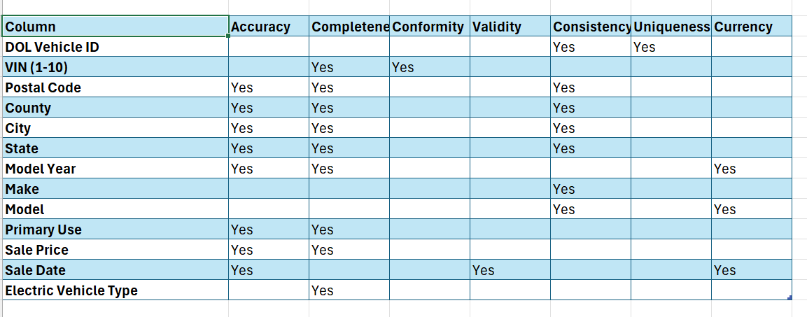
Data Profiling

Slide 9
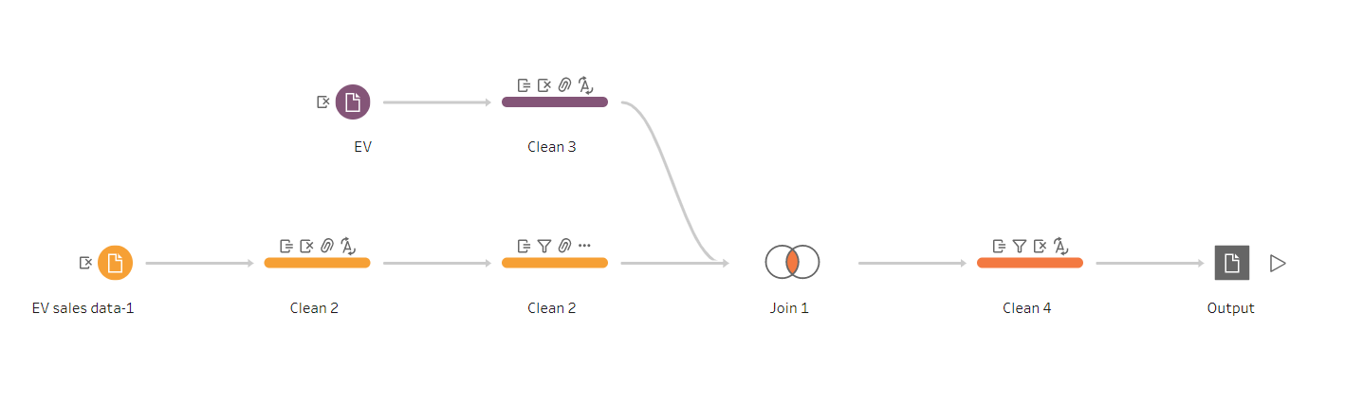
Data Preprocessing

Slide 10
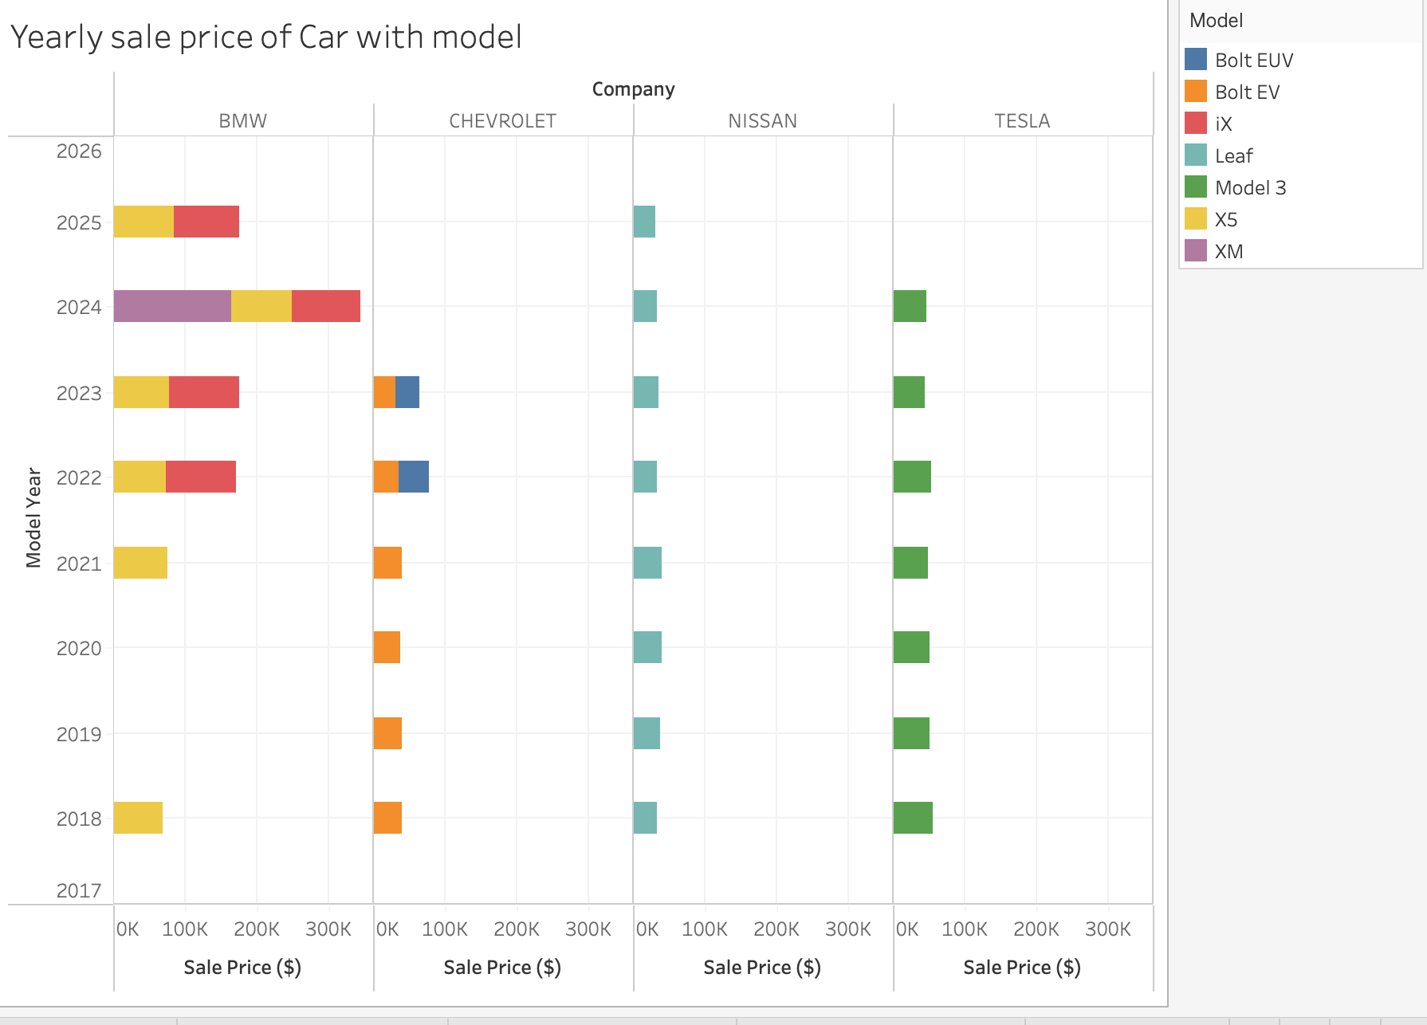
Insights

Slide 11
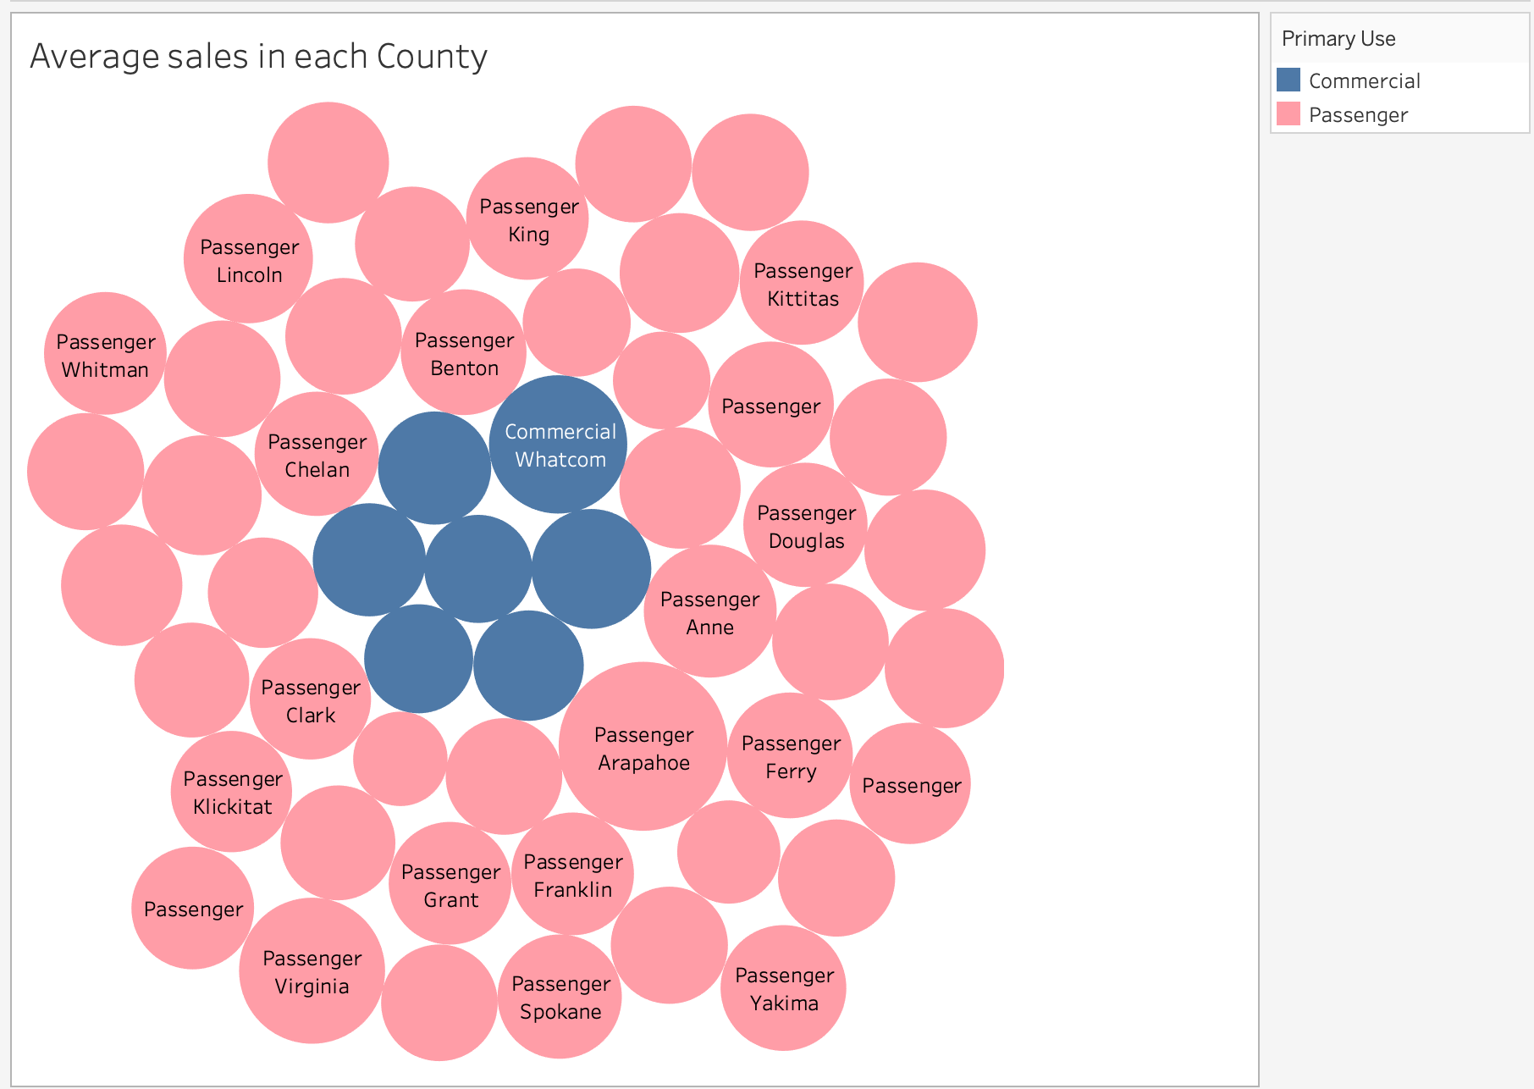
Insights

Slide 12
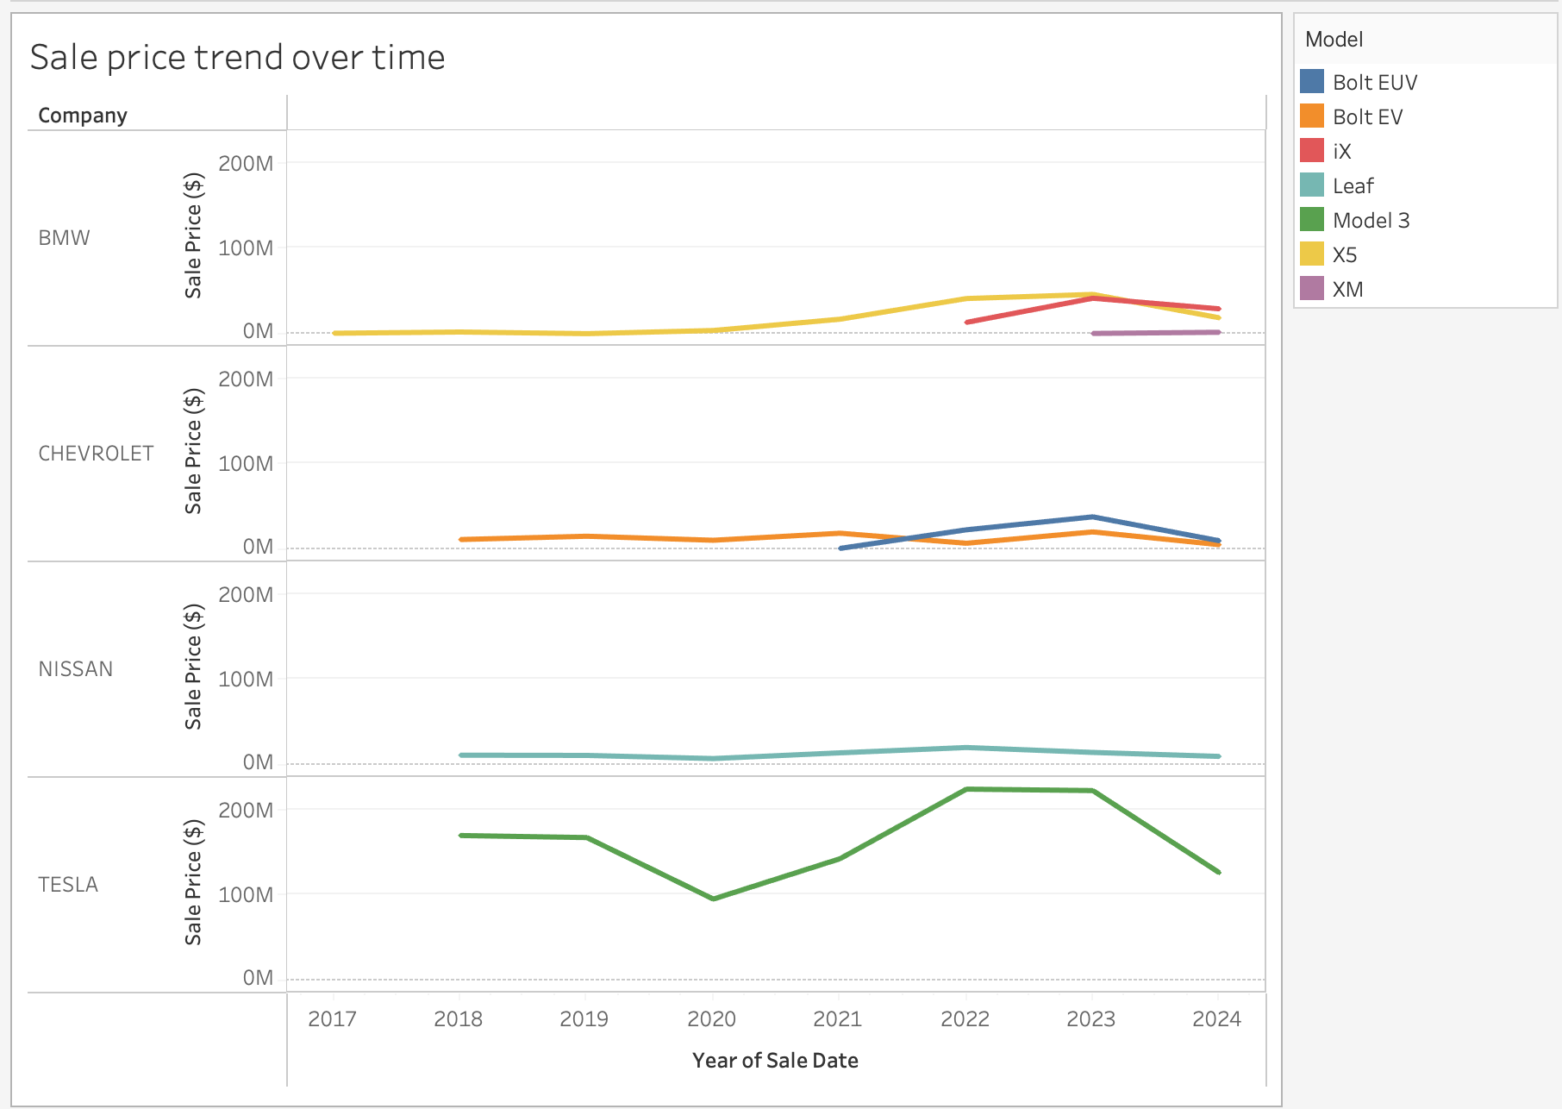
Insights

Slide 13
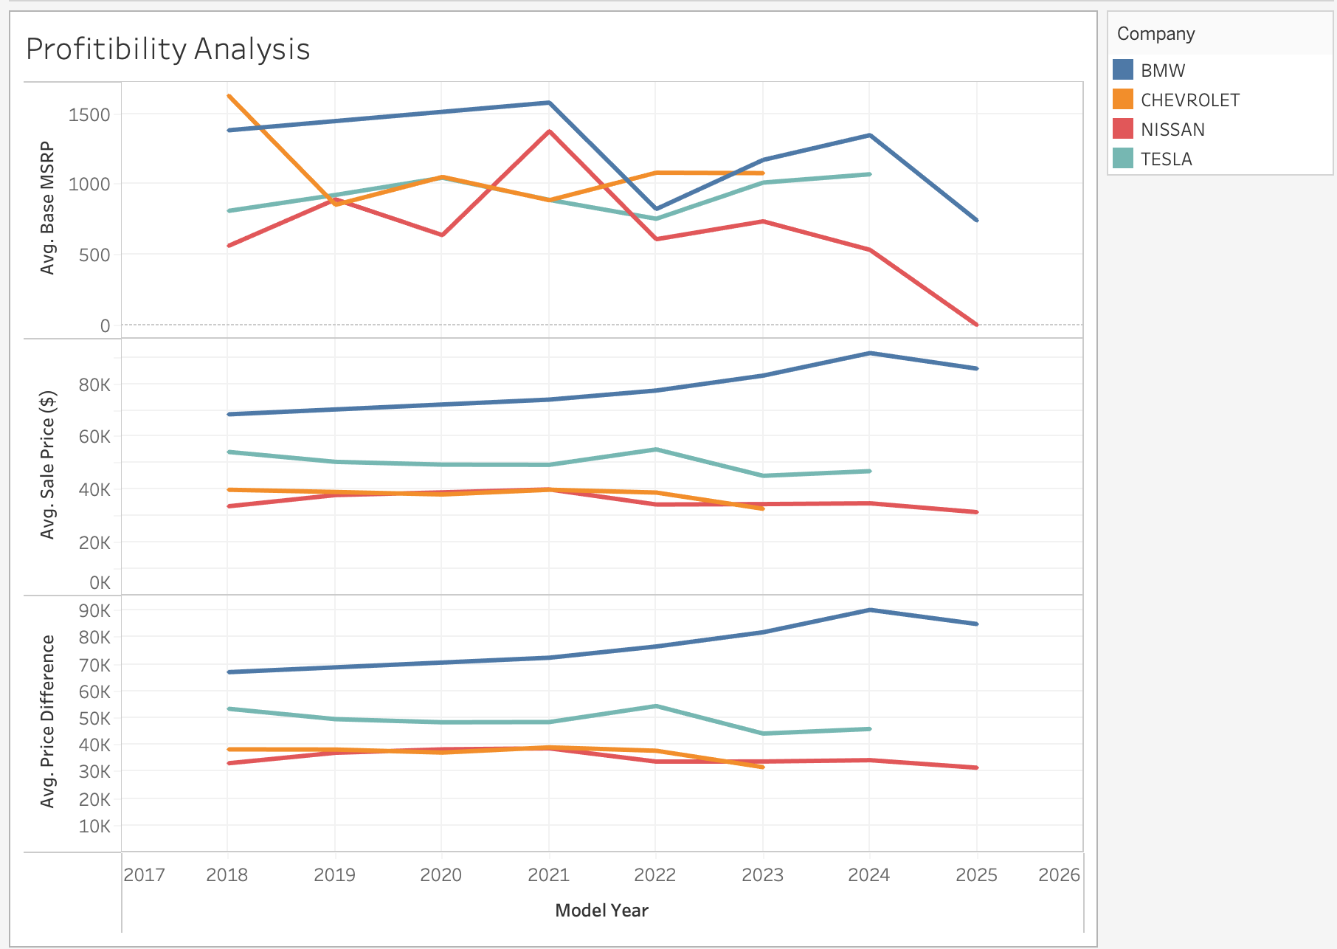
Insights

Slide 14
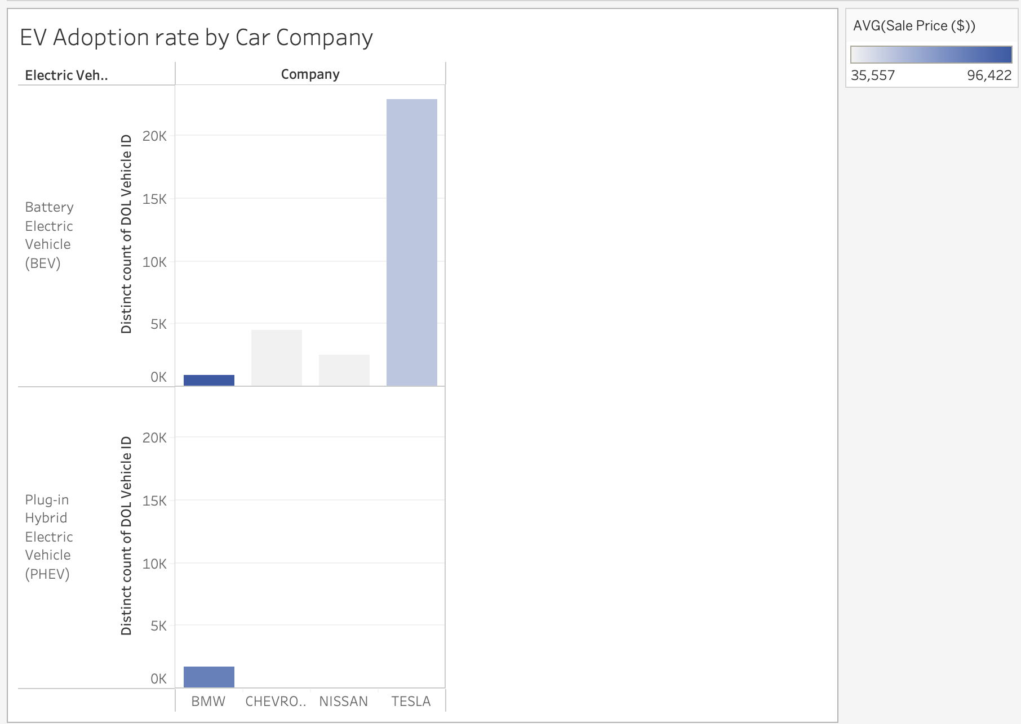
Insights

Slide 15
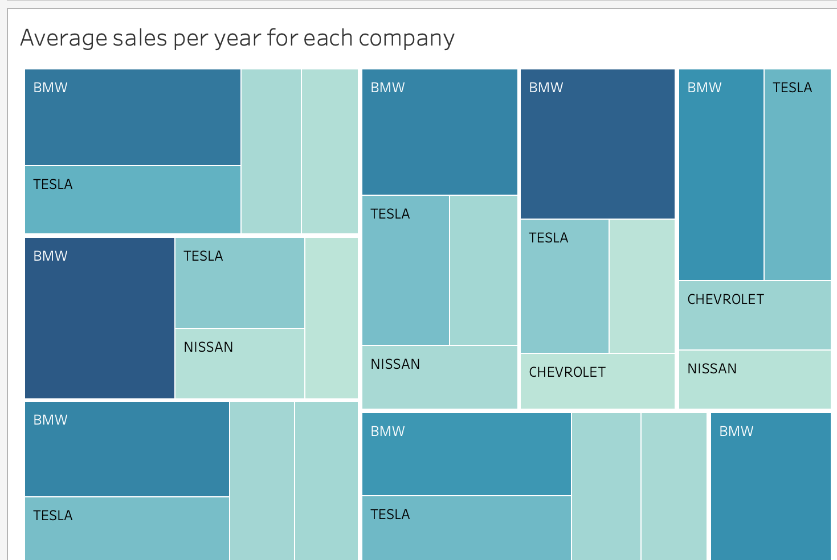
Insights

Slide 16
Conclusion
These insights help identify where infrastructure improvements and incentives are needed to accelerate EV adoption, guiding policymakers, manufacturers, and environmental organizations toward informed decisions.

Slide 17




Kontakt:
Max Mustermann
SRH Holding (SdbR)
Bonhoefferstraße 1
69123 Heidelberg
T +49 6221 8223-0
info@srh.de
www.srh.de

